Slide 1





Alex Pshul
Senior Software Consultant
@AlexPshul
https://www.pshul.com
http://codevalue.net

Slide 2

Remember?
Scrapyard Wars 7 Pt 1 - NO INTERNET (Linus Tech Tips)
https://www.youtube.com/watch?v=9C2DHfIXKIo

Slide 3






So many apps

Slide 4

About Me
Alex Pshul
Senior Software Consultant @CodeValue Ltd.
More than 8 years of hands on experience
OzCode Evangelist (www.oz-code.com)
Talk to me about:
Software Development
Hardware and Gadgets
Gaming
Animals
@AlexPshul
https://www.pshul.com

Slide 5
Azure Maps
What is Azure Maps?

Slide 6

Azure Maps
A portfolio of geospatial services
Maps
Routing
Search
Time Zones
Traffic
Use Familiar Azure Concepts
Rest APIs
Different price tiers

Slide 7





Azure Maps
Azure Based API | Dedicated Bing API | Dedicated Google API
Differences in Map Coverage

Slide 8

Azure Maps
Maps and Traffic Tiles
25,000 free calls per Month
IP to Location
0.5$ per 1000 calls
Aerial Imagery
5,000 free calls per Month
Time Zone
IP to Location
All Others
25,000 free calls per Month
0.25$ per 1000 calls

Slide 9
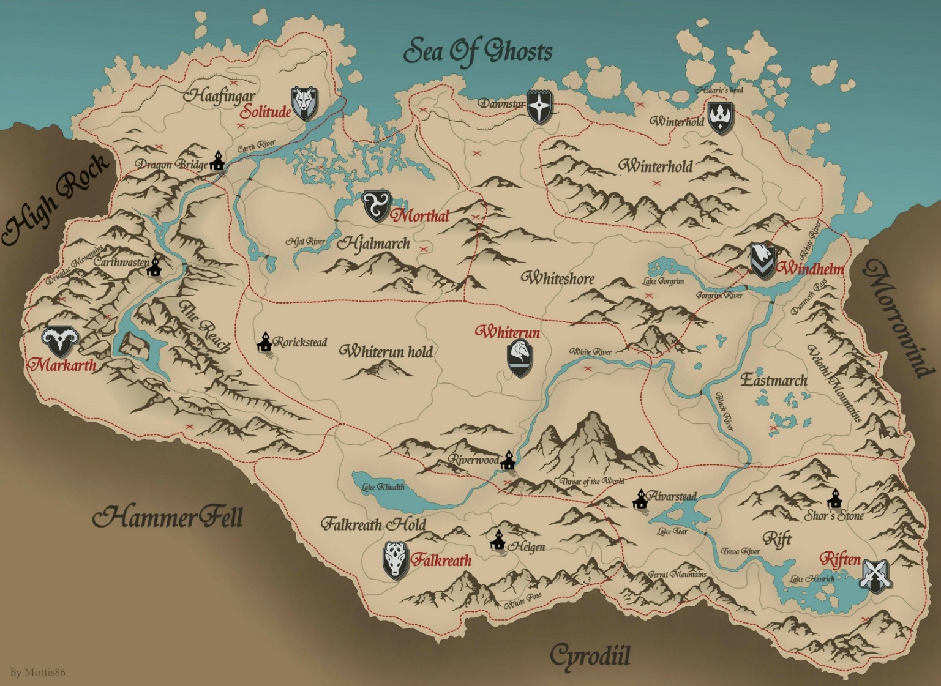
Azure Maps
Render
Map Copyrights
General caption
For a tile
For the world
From a bounding box
Map
Images
Tiles
http://i.imgur.com/TFUwF.jpg

Slide 10
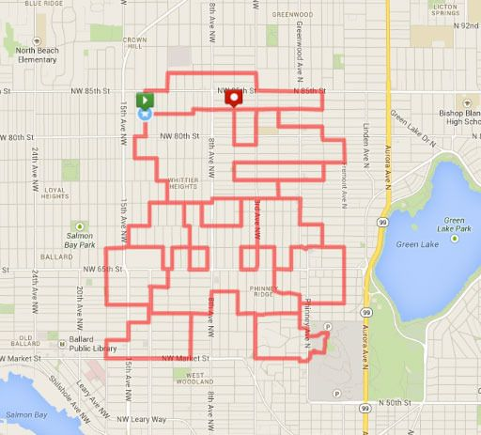
Azure Maps
Route
Route Directions
Get or Post
Lots of different query parameters
Travel Mode
Avoid
Traffic
Route Type
Language
Arrive At / Depart At
Many more…
MapMyRun Facebook page
https://www.facebook.com/mapmyrun/

Slide 11

Azure Maps
Search
Address
Free text
Structured
Reverse regular
Reverse cross street
Fuzzy – a free text search
POI
Regular
Nearby
Category
Along Route
Inside Geometry

Slide 12

Azure Maps
Time Zones
Time zone
By Coordinates
By ID
Time zone enum
IANA
Windows
IANA Version
Convert Windows To IANA
The Problem with Time & Timezones - Computerphile
https://www.youtube.com/watch?v=-5wpm-gesOY

Slide 13

Azure Maps
Traffic
Flow
Segment
Tile
Incident
Detail
Tile
Viewport
https://commons.wikimedia.org/wiki/File:Miami_traffic_jam,_I-95_North_rush_hour.jpg

Slide 14

Xamarin
A complete cross-platform UI toolkit for .NET developers

Slide 15
Xamarin
May 16th, 2011.
Miguel de Icaza, on of the founders of Ximian, announces that Mono will be developed by a new company – Xamarin.
July 17th, 2013.
Xamarin receives a total of $16 million in funding.
February 24th, 2016.
Xamarin is acquired by Microsoft for an estimated sum between 400 and 500 million US dollars.
August 4th, 2003.
Ximian is acquired by Novell.
December, 2012.
Xamarin releases Xamarin.Mac
July 19th, 2001.
Mono is launched as an open source project in the Ximian company.
July, 2011.
Novell grants all the Mono licenses to Xamarin.
August 21st, 2014.
Xamarin closed additional $54 million in funding.
April, 2011.
Novell is aquired by Attachmate, which laysoffs hundreds of employees, including the Mono developers.
February, 2013.
Xamarin 2.0 is released, which includes Xamarin Studio and Visual Studio integration.

Slide 16
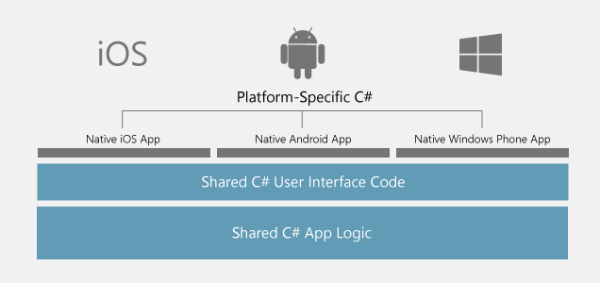
Xamarin
Shared Business Logic
Shared User Interface
Platform specific API
Platform specific customization
Platform specific behavior
C# for coding
XAML for user interface
https://visualstudio.microsoft.com/xamarin/

Slide 17

XaMap
Our own navigation app

Slide 18
XaMap
Services
Navigation Service
Handles the navigation lifecycle
Handles the navigation mock data
New location event for movement mock
Map Calculations
Different map conversions
Search Service
Handles all the cloud map operations:
Fuzzy Search
Get Directions

Slide 19

XaMap
CODING TIME

Slide 20



XaMap
Presentation Layer
MVVM
Although not used in this demo, an MVVM framework is strongly recommended!
Logical part in App = View + View Model
Converters
Xamarin Custom Map Renderer
ReactiveUI
Caliburn.Micro
Prism

Slide 21
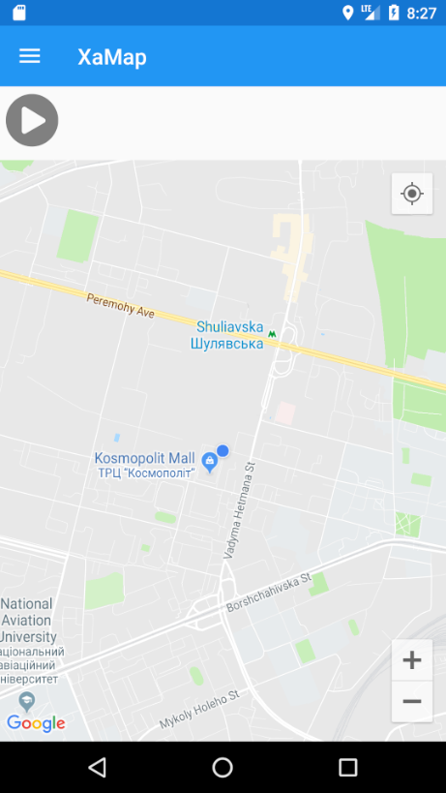
XaMap
Main Page
Master Detail Page
Initializes other views and view models of the app
Allows to show/hide the search view

Slide 22
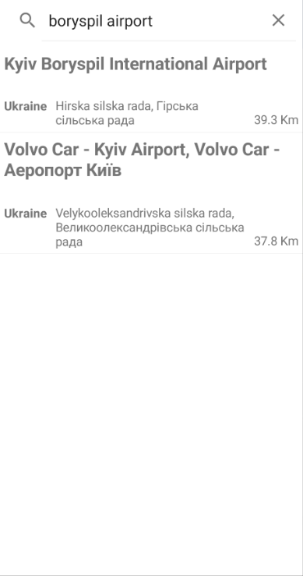
XaMap
Search Pane
Utilizes our Search Service
Makes a fuzzy search from the string provided by the user
Receives all the possible routes for all the fuzzy results
Shows results details to the user

Slide 23
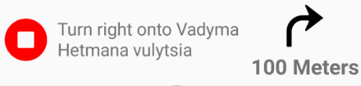
XaMap
Action Panel
After the destination is selected, display the user an option to start navigating
Show route instructions
https://github.com/mapbox/directions-icons
Allow the user to stop navigating

Slide 24
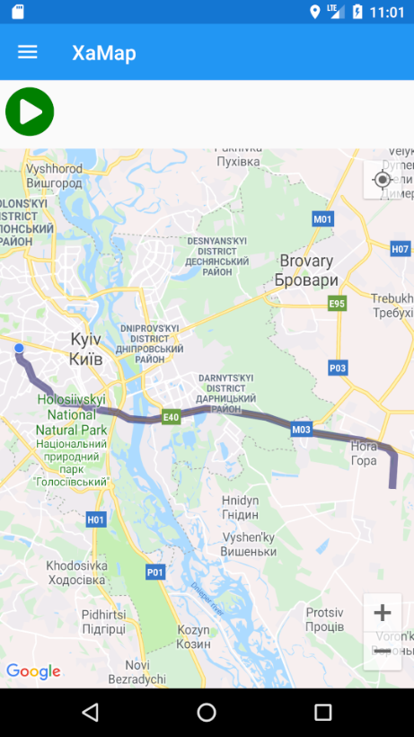
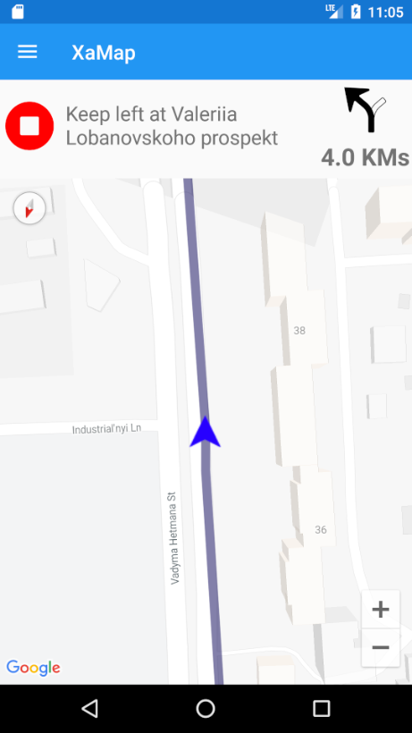
XaMap
Map
Custom Map Control with Custom Renderers on each platform
After the user selects a destination, display a route overview
Upon navigation, display user arrow and update map camera

Slide 25

WE ARE DONE

Slide 26

Summary
To build a navigation app, you don’t need much today
Choose a map API for your needs
Use a fuzzy search on a text to get geolocations
Get routes to these locations
Use a tool to develop a cross platform app
Integrate a map into your app
Let the user decide on the route
Show the selected route on the map
What’s next?
Explore more possibilities
Map APIs are not only for navigating but for a lot more!

Slide 27

Resources
Azure Maps Documentation https://docs.microsoft.com/en-us/azure/azure-maps/
Xamarin Documentation https://docs.microsoft.com/en-us/xamarin/
Xamarin University https://university.xamarin.com/
Full demo and slides: https://github.com/AlexPshul/XaMaps

Slide 28
Alex Pshul
Senior Software Consultant
@AlexPshul
https://www.pshul.com
https://github.com/alexPshul

